Slide 1
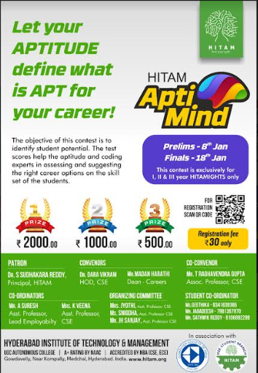
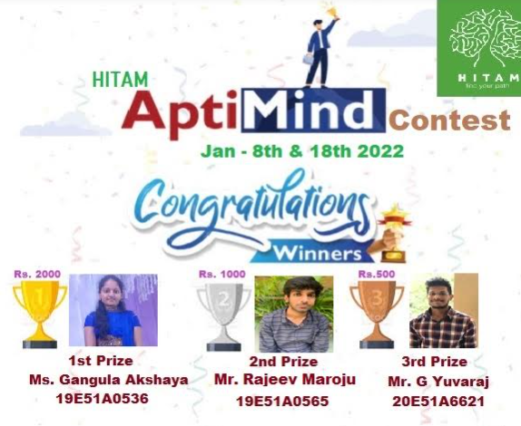
Apti Mind
  Date: 18/01/2022

Slide 2

Workshop On React JS
  Date: 10/12/2021

Slide 3
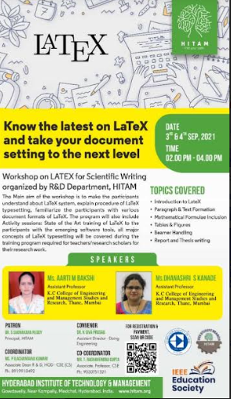
LATEX Workshop
  Date: 4/9/2021

Slide 4
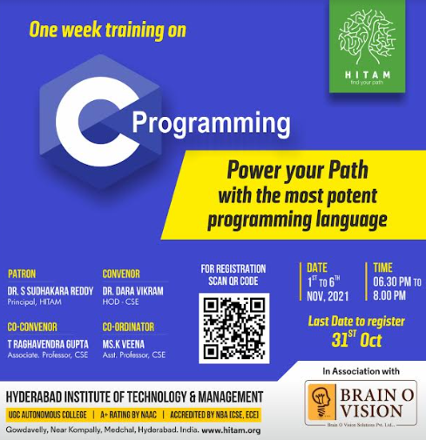
Power Your Path
  Date: 6/11/2021

Slide 5
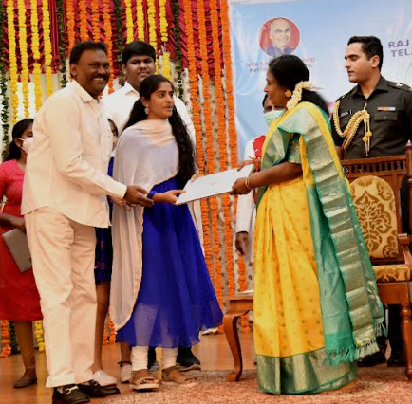
At a special event conducted at the Raj Bhavan in Hyderabad on May 29, 2022, Telangana Governor Dr. Tamilisai Soundararajan presented a few laptops to the state's deserving pupils. Among 1200 students, Ms. Sravani, a second-year CSE student at Hyderabad Institute of Technology and Management, received a laptop from the governor.

