Slide 1


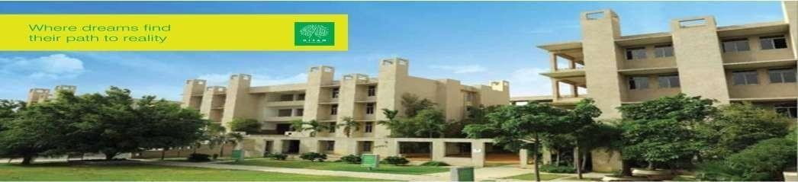
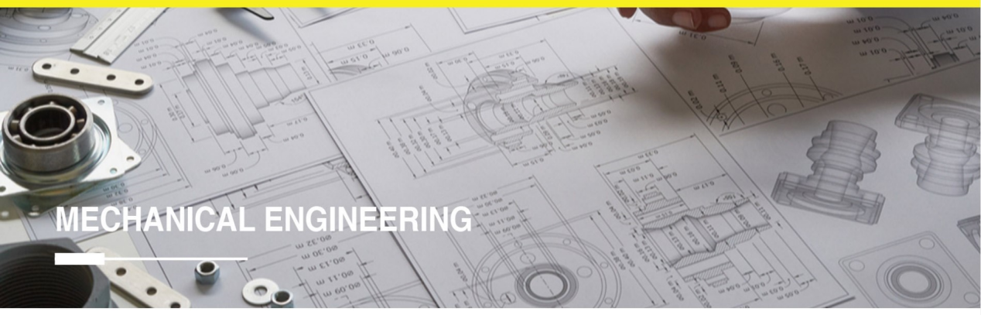
Hyderabad Institute of Technology And
Management
Volume 13 -ISSUE of May 2023- August 2023
P A G E 1
CONTENT
Department of Mechanical Engineering News Letter .
Chief Patrons :
Sri.Prashanth Arutla
(Chairman Royal Educational Society)
Editorial Team:
Mr Santhosh Naik(Editor-in-chief).
Dr.Rajesh Panakala
Principal,HITAM
.Giridhar & G.Ram Prasad
(Editor)

Slide 2



“
Hyderabad Institute of Technology And
Management
P A G E 2
Vision of Institute:-
NEWS LETTER
“To be a role model technological university of national repute that imparts research-based multi-disciplinary competencies in students to enable their career aspirations and contribute to society. ”
Vision and Mission of Institute
Mission of Institute:-
Build students’ competencies through HITAM’s ‘Doing Engineering’ approach with relevant curriculum, pedagogy and assessment.
Collaborate with industry and institutions for capacity building in research, innovation and real time knowledge.
Develop employability skills for emerging trends and societal needs
Excel by adopting NEP 2020 and improving accreditations &amp; national rankings.

Slide 3

Hyderabad Institute of Technology And
Management
P A G E 3
Vision of Department:-
“To be a globally recognized hub for mechanical engineering education and research, driving transformative solutions in energy, manufacturing, robotics, and sustainable design. We strive to cultivate a diverse community of engineers who lead with creativity, integrity, and a commitment to improving society through engineering innovation”.
Vision and Mission of Department
Mission of Department:-
The Mechanical Engineering Department is dedicated to fostering innovation, excellence, and leadership in education, research, and professional practice.
We aim to equip students with cutting-edge technical knowledge, practical skills, and ethical values to address global engineering challenges and contribute to sustainable technological advancements.

Slide 4

Hyderabad Institute of Technology And
Management
P A G E 4
Program Educational Objectives (PEOs)
NEWS LETTER
Program Educational Objectives
PEO 1: Graduates will excel in applying mechanical engineering principles to design and innovate solutions in industries such as energy, automotive, and manufacturing.
PEO 2: Graduates will contribute to technological advancements through research and development, addressing global challenges in sustainability and advanced systems.
PEO 3: Graduates will demonstrate leadership and collaboration in multidisciplinary teams, delivering ethical and sustainable engineering solutions.

Slide 5

Hyderabad Institute of Technology And
Management
P A G E 5
NEWS LETTER
Mr. Santosh Naik along with his team organised a workshop on 'Moodle on OER' on 26th April 2023. HITAM-TLC took the initiative to aware the faculty members of how to create and upload class materials through youtube in Moodle.
Dr. K. Siva Prasad, Professor and Assistant Director, Doing Engineering has been honoured with the ‘Research Excellence Award’ by Alpha International Publication, Registered under the Ministry of SME, Government of India.
Mr. Santosh Naik, faculty, Department of Mechanical Engineering received a certificate of Appreciation for IUCEE Faculty Mentor for Basics of Prompt Engineering Learn to communicate better with AI.
Achievements

Slide 6
Hyderabad Institute of Technology And
Management
P A G E 6
NEWS LETTER
EWB HITAM received two best presentation awards for SDG 6 & SDG 9 in EWB AIM 2023 at GITAM University
On 6th July 2023, HITAM-IIC conducted a workshop on Design Thinking with the title, “Cultivating the cognitive capabilities to spark ideation and drive innovation”. The Key Speaker of the workshop was Dr. William Oakes (Director, EPICS Program and Professor, Engineering Education, USA). The workshop focused on achieving practical results and solutions that are feasible technically, economically, and desirable for the user.
Seminar on Entrepreneurship as a panacea for the development of the country” HITAM - EDC-IIIC organized a seminar on “Entrepreneurship is a Panacea for the development of the country” on 21st September 2023. The Speaker of the seminar was Ms. Supriya Gholat, an international transformation speaker and coach. Also, she is an author of an unconventional book named “40 seconds”. Around 80 HITAMights registered and attended the seminar.
Achievements

Slide 7
Hyderabad Institute of Technology And
Management
P A G E 7
NEWS LETTER
Engineers Day was celebrated in HITAM Campus on 15th September 2022. Er G. Siva Rama Krishna Reddy, Scientist F, DRDL, Hyderabad was the Chief Guest of the Day. There were around 37 faculty members and students who participated in the program. Dr. P. Rajesh Kumar, Principal, HITAM gave the welcome address to the students narrating the Achievements and Contributions of Sir Mokshagundam Visveraya, on his birth anniversary. Followed by Dr. Rama Mohan, Academic Director, HITAM, who emphasized the current global challenges for Engineers, and Dr. S. Arvind, Dean-academics, HITAM shared his insights on the role of academics to meet the industry expectations. Finally, Er G. Siva Rama Krishna Reddy, the chief guest spoke the about the current trends in industries and skill development among engineers to address the challenges. A quiz competition was conducted for the HITAMIGHTS on Engineers Day
Engineers Day
Celebration

Slide 8
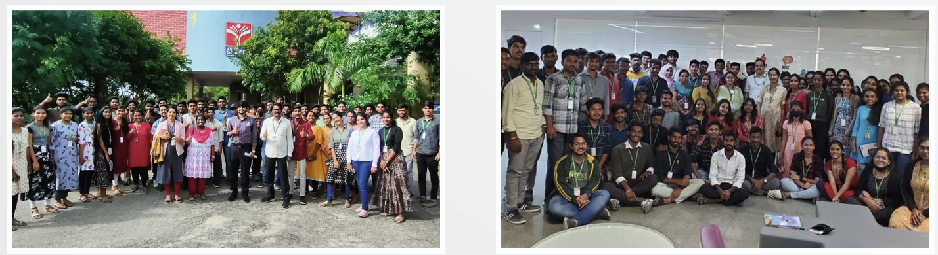
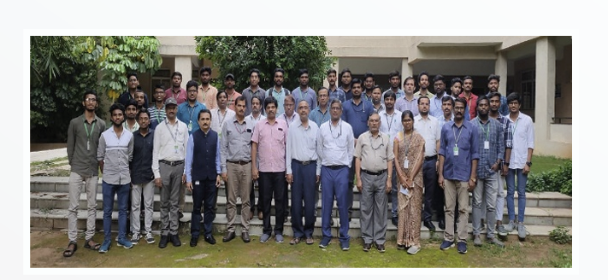
P A G E 8
P A G E 7

