Slide 1


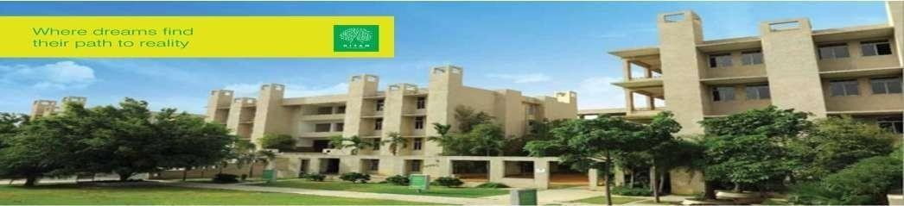

Hyderabad Institute of Technology And
Management
Volume 12 -ISSUE of Jan 2023- April 2023
P A G E 1
CONTENT
Department of Mechanical Engineering News Letter .
Chief Patrons :
Sri.Prashanth Arutla
(Chairman Royal Educational Society)
Editorial Team:
Ms N Krishnaven (Editor-in-chief).
Dr.Rajesh Panakala
Principal,HITAM
M Sai Nadh & P Charan Kumar
(Editor)

Slide 2



“
Hyderabad Institute of Technology And
Management
P A G E 2
Vision of Institute:-
NEWS LETTER
“To be a role model technological university of national repute that imparts research-based multi-disciplinary competencies in students to enable their career aspirations and contribute to society. ”
Vision and Mission of Institute
Mission of Institute:-
Build students’ competencies through HITAM’s ‘Doing Engineering’ approach with relevant curriculum, pedagogy and assessment.
Collaborate with industry and institutions for capacity building in research, innovation and real time knowledge.
Develop employability skills for emerging trends and societal needs
Excel by adopting NEP 2020 and improving accreditations &amp; national rankings.

Slide 3

Hyderabad Institute of Technology And
Management
P A G E 3
Vision of Department:-
“To be a globally recognized hub for mechanical engineering education and research, driving transformative solutions in energy, manufacturing, robotics, and sustainable design. We strive to cultivate a diverse community of engineers who lead with creativity, integrity, and a commitment to improving society through engineering innovation”.
Vision and Mission of Department
Mission of Department:-
The Mechanical Engineering Department is dedicated to fostering innovation, excellence, and leadership in education, research, and professional practice.
We aim to equip students with cutting-edge technical knowledge, practical skills, and ethical values to address global engineering challenges and contribute to sustainable technological advancements.

Slide 4

Hyderabad Institute of Technology And
Management
P A G E 4
Program Educational Objectives (PEOs)
NEWS LETTER
Program Educational Objectives
PEO 1: Graduates will excel in applying mechanical engineering principles to design and innovate solutions in industries such as energy, automotive, and manufacturing.
PEO 2: Graduates will contribute to technological advancements through research and development, addressing global challenges in sustainability and advanced systems.
PEO 3: Graduates will demonstrate leadership and collaboration in multidisciplinary teams, delivering ethical and sustainable engineering solutions.

Slide 5

Hyderabad Institute of Technology And
Management
P A G E 5
NEWS LETTER
Mr. V. Giridhar (3rd Year, ME); Mr.K. Keerthan (3rd Year, ME) received undergraduate fellowship grant of 2.5 Lakhs for their project SpiCEN.
Students from B.Tech 3rd Year, Branch-CSM, Ms. A. Nymisha Nandini Reddy, Ms. D. Pavani, Ms. B. Shiva Rakshitha, Ms. Neha Saw, along with Mr. Santosh Naik, faculty, Mechanical Engineering presented a paper on “an autonomous robot for removing Underwater pollution: OCTACLEANER” in IEEE 3rd International conference on “ Technology, Engineering, Management for Societal impact using Marketing, Entrepreneurship & Talent (TEMSMET 2023)” organized by Vidya Vikas Institute of Engineering and Technology, Mysure on 10th & 11th February 2023.
18 Students from HITAM Participated in IASF/ICTIEE 2023 Conference. Students conducted ATAL thinking lab in St. Peters School Sanga Reddy as an Innovation & Entrepreneurship Activity.
3 Students Project shortlisted for Exhibition Unnat Bharat Abhiyan Mahotsav & Expo Unnati held in IIT Delhi.
XPLORE & SSDC MECH – 04 Students presented their project in Quest Global Ingenium 2023 held in Kochi, Kerala. HYDERABAD INST
Achievements

Slide 6
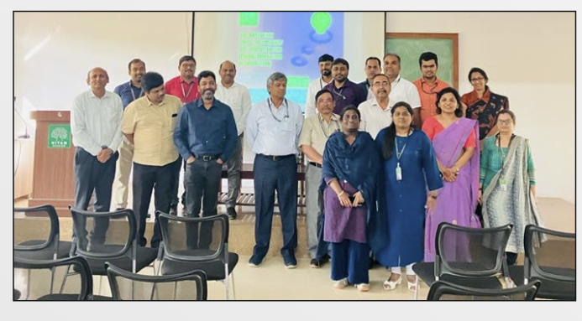
Hyderabad Institute of Technology And
Management
P A G E 6
NEWS LETTER
HITAM- IIIC and EDC organized a Technical Idea presentation from Multi-Disciplinary streams on 28th January 2023 at whixh 2nd prize was awarded to Mr. Y. Anil Reddy, faculty, Department of Mechanical Engineering
Achievements

Slide 7
Hyderabad Institute of Technology And
Management
P A G E 7
NEWS LETTER
Students of B.Tech 1st year( CSO, CSM, CSC and MECH) along with 5 faculty members visited NIPER on 10th February 2023. 190 students visited NIPER Research lab-Avishakaran to see some of the innovations and start-ups under their innovation cell. The purpose of the visit was to make the students strive towards excellence in the field of higher education and research in pharmaceutical science and management.
Mr. Santosh Naik, faculty, Mechanical Engineering, and Mr. Surendra Bandi (faculty, Computer Science Engineering) Presented 02 Papers at the ICTIEE 2023 Conference on the topic, “Impact of Service Learning in Engineering Education–A Case Study” and “Impact of Sustainable Development on Climate Change and Student Learnings” and published the same Papers in JEET (Scopus) Journal.
.
Achievements

Slide 8
Hyderabad Institute of Technology And
Management
P A G E 8
NEWS LETTER
Mr. Santosh Naik, faculty, Mechanical Engineering, was selected as a reviewer at International Conference in Contemporary Computing and Communication (InC4) at Christ University. Skill Development Program @HITAM
Mr. Santosh Naik, faculty, Mechanical Engineering has participated as a Program Committee member and Reviewer in the 5th International Conference on Communication and Computational Technology held during 28th-29th January 2023.
Mr. Santosh Naik was selected as a Program Committee member & Reviewer for World Conference on Artificial Intelligence: Advances and Applications (WCAIAA 2023) held during March 18-19, 2023 in Sri Padampat Singhania University.
.
Achievements

Slide 9
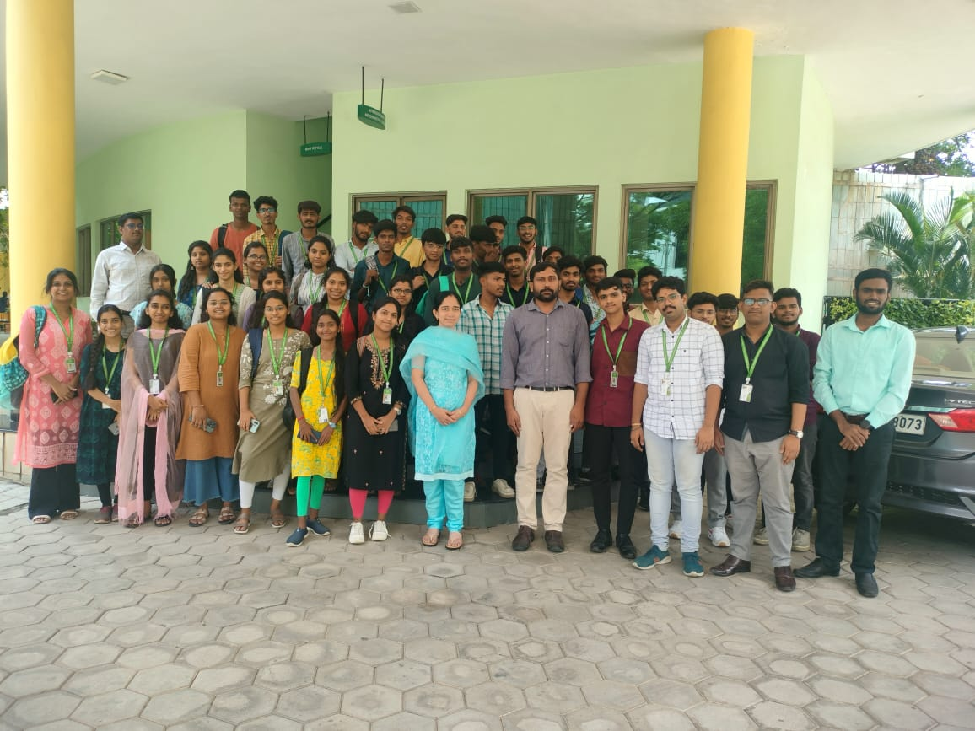
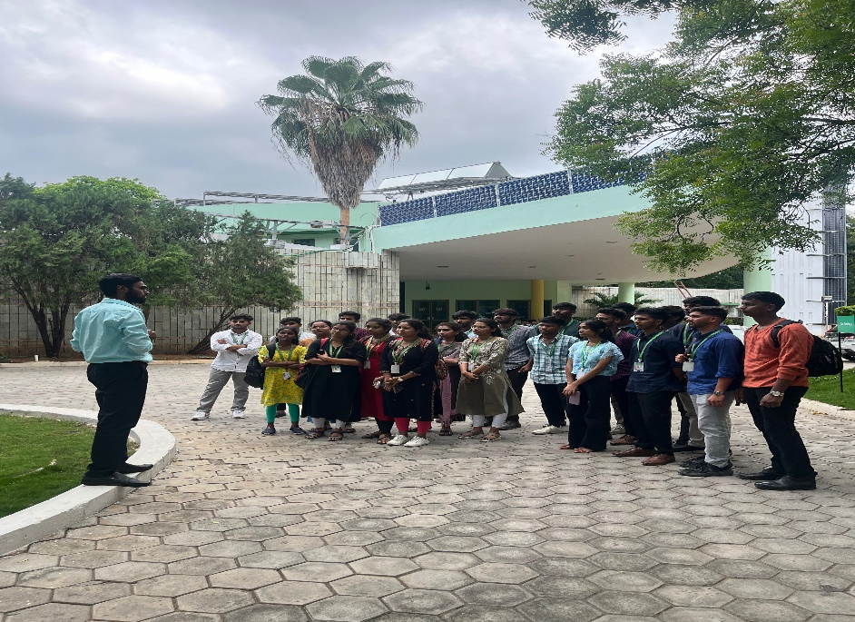
Hyderabad Institute of Technology And
Management
P A G E 9
NEWS LETTER
· Students explored innovative green technologies like energy-efficient lighting, rainwater harvesting systems, waste management, and renewable energy systems.
· The visit also included case studies of iconic green buildings certified by IGBC and their impact on the environment and communities.
IGBC Visit

Slide 10
Hyderabad Institute of Technology And
Management
P A G E 10
NEWS LETTER
· It was a proud moment for us when we celebrated Indian Army Day on 15th January 2023 at HITAM Campus. The day is celebrated, in recognition of Lieutenant General Kodandera M. Cariappa's (later who became Field Marshal) taking over as the first Commander-in-Chief of the Indian Army from General Francis Roy Bucher, the last British Commander-in-Chief of India, on 15 January 1949. Colonel A V Subramanyam, Registrar-HITAM, and Dr. P . Rajesh Kumar, Principal-HITAM as a guest addressed the students on the auspicious occasion. The participants for the event were students, faculty members, and staff from HITAM.
Indian Army Day celebration

