Slide 1


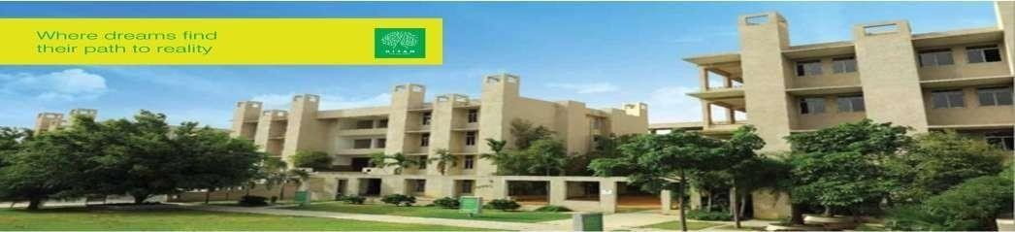

Hyderabad Institute of Technology And
Management
Volume 9 -ISSUE of Jan 2022- April 2022
P A G E 1
CONTENT
Department of Mechanical Engineering News Letter .
Chief Patrons :
Sri.Prashanth Arutla
(Chairman Royal Educational Society)
Editorial Team:
Mr Y Anil Reddy (Editor-in-chief).
Dr.Rajesh Panakala
Principal,HITAM
K Ajay & T Shilpa
(Editor)

Slide 2



“
Hyderabad Institute of Technology And
Management
P A G E 2
Vision of Institute:-
NEWS LETTER
“To be a role model technological university of national repute that imparts research-based multi-disciplinary competencies in students to enable their career aspirations and contribute to society. ”
Vision and Mission of Institute
Mission of Institute:-
Build students’ competencies through HITAM’s ‘Doing Engineering’ approach with relevant curriculum, pedagogy and assessment.
Collaborate with industry and institutions for capacity building in research, innovation and real time knowledge.
Develop employability skills for emerging trends and societal needs
Excel by adopting NEP 2020 and improving accreditations &amp; national rankings.

Slide 3

Hyderabad Institute of Technology And
Management
P A G E 3
Vision of Department:-
“To be a globally recognized hub for mechanical engineering education and research, driving transformative solutions in energy, manufacturing, robotics, and sustainable design. We strive to cultivate a diverse community of engineers who lead with creativity, integrity, and a commitment to improving society through engineering innovation”.
Vision and Mission of Department
Mission of Department:-
The Mechanical Engineering Department is dedicated to fostering innovation, excellence, and leadership in education, research, and professional practice.
We aim to equip students with cutting-edge technical knowledge, practical skills, and ethical values to address global engineering challenges and contribute to sustainable technological advancements.

Slide 4

Hyderabad Institute of Technology And
Management
P A G E 4
Program Educational Objectives(PEOs)
NEWS LETTER
Program Educational Objectives
PEO 1: Graduates will excel in applying mechanical engineering principles to design and innovate solutions in industries such as energy, automotive, and manufacturing.
PEO 2: Graduates will contribute to technological advancements through research and development, addressing global challenges in sustainability and advanced systems.
PEO 3: Graduates will demonstrate leadership and collaboration in multidisciplinary teams, delivering ethical and sustainable engineering solutions.

Slide 5

Hyderabad Institute of Technology And
Management
P A G E 5
NEWS LETTER
Rankings & Accreditations: HITAM secured an A+ grade from NAAC and NBA. In 2022, the B.Tech program was ranked #90 nationally by Times.
Mr. P. Praveen actively participated in a Workshop on “Course Outcomes and Attainment Process” conducted at Gulbarga Shetty College on 21st March 2023, focusing on outcome-based education (OBE) strategies.
Dr. K. Siva Prasad served as Principal Investigator (PI) for the project “Agri Bot”, completed over a duration of six months with a funding of ₹0.17 lakhs. The project focused on feasibility analysis, design documentation, initial hardware setup, and basic bot dry-run operations.
Dr. K. Siva Prasad also led a project titled “An Automation System for HR Operations”, completed in three months with a sanctioned amount of ₹0.37 lakhs. The project involved MVP design, development, and automation of core HR workflows.
Highlights
& Institutional Achievements

Slide 6
Hyderabad Institute of Technology And
Management
P A G E 6
NEWS LETTER
Dr. K. Siva Prasad published a patent titled “Gas Sensor Model for Sensitizing a Selective Element in a Mixture of Gases” on 4th February 2022 (Application No. 20214105912).
Mr. G. Singaiah and Dr. K. Siva Prasad jointly published a patent on “Mechanical Characterization of Loam Sandy Soil Mixed with Micro Silica for Structural Applications” on 4th February 2022 (Application No. 20224100220).
A team of faculty including Dr. B. Venkatesh, Dr. K.V.P. Chakradhar, Dr. K. Deepak, Dr. Sreeramulu Munagala, and Dr. P.V. Durga Prasad published a patent titled “Advanced Robotic Controlled Land Vehicles” on 16th March 2022 (Application No. 20224101439).
Faculty Patents Published

Slide 7
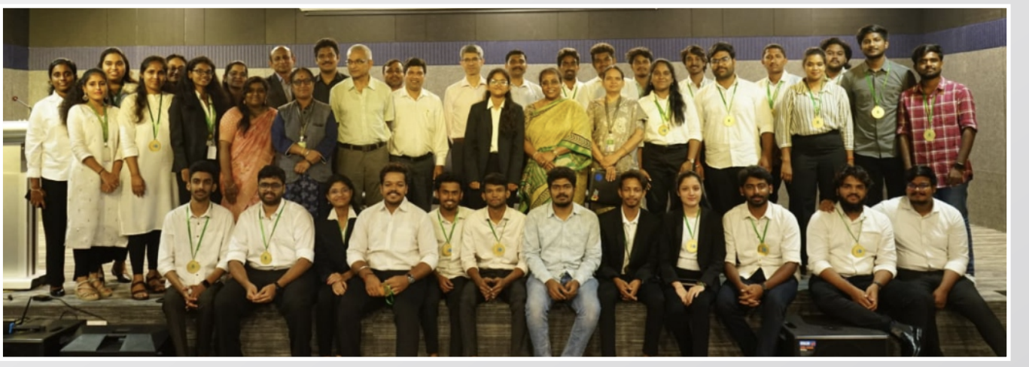
Hyderabad Institute of Technology And
Management
P A G E 7
NEWS LETTER
The Department of Mechanical Engineering at HITAM conducted impactful Faculty Development Programs during the academic year 2022–2023 to enhance technical knowledge and promote interdisciplinary learning.
Seven-Day FDP on "Recent Advances in Heat Transfer and Fluid Mechanics was conducted on 10th February 2022 .Dr. Siva Rama Krishna Reddy, Industry Expert was the resource person .The FDP had about 40 participants involved. The program focused on both fundamental and applied aspects of heat transfer and fluid dynamics, with relevance to real-world engineering systems and simulations.
Achievements

Slide 8
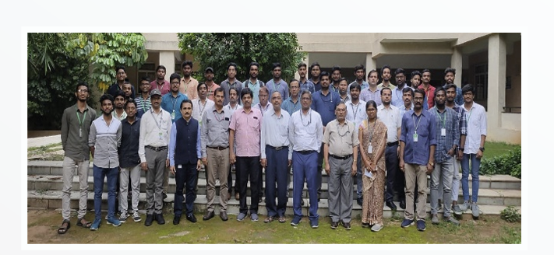
Hyderabad Institute of Technology And
Management
P A G E 8
NEWS LETTER
  Students secured prizes with highlights such as first place in PPT and project competitions, including prizes for Prudhvi Yashwanth Reddy & Shaik Mahammad Bilal NRTEC.
  Mr. Santosh Naik, faculty, Mechanical Engineering has participated as a Program Committee member and Reviewer in the 4th International Conference on Communication and Computational Technology held during 28th-29th January 2022.
.
Achievements

Slide 9
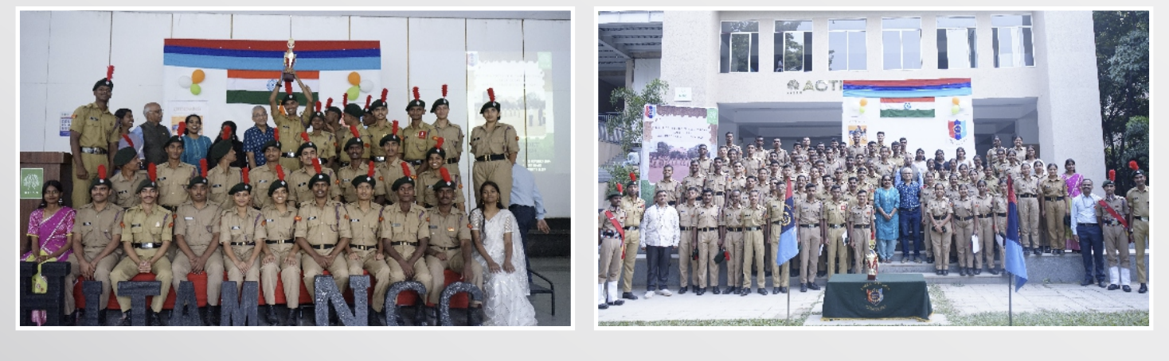
Hyderabad Institute of Technology And
Management
P A G E 9
NEWS LETTER
The Hyderabad Institute of Technology and Management (HITAM) celebrated the 73rd Republic Day of India with great enthusiasm, patriotism, and a sense of national pride on 26th January 2023.
The event was held in the campus courtyard and attended by students, faculty, and staff.The celebration commenced with the hoisting of the national flag by the Director, followed by the singing of the National Anthem, creating an atmosphere of unity and reverence.
In his address, the Director highlighted the importance of the Constitution of India and encouraged students to become responsible citizens contributing positively to the nation.
Republic day celebration

Slide 10
Hyderabad Institute of Technology And
Management
P A G E 10
NEWS LETTER
Mr SNS Santosh has contributed significantly to make the event enhancing.Students from various departments presented patriotic songs, speeches, and cultural performances reflecting the spirit of the day.
A special skit by Mechanical Engineering students emphasized the role of youth in building a progressive and inclusive India.
The event concluded with a vote of thanks and the distribution of refreshments. The celebration served as a reminder of India’s democratic values and HITAM's commitment to fostering civic responsibility and national spirit among students.
Republic day celebration

