Slide 1




Hyderabad Institute of Technology And
Management
Volume 11 -ISSUE of September 2022- December 2022
P A G E 1
CONTENT
Department of Mechanical Engineering News Letter .
Chief Patrons :
Sri.Prashanth Arutla
(Chairman Royal Educational Society)
Editorial Team:
Mr Santosh Naik (Editor-in-chief).
Dr.Rajesh Panakala
Principal,HITAM
K.Sandeep & G.Nithin
(Editor)

Slide 2



“
Hyderabad Institute of Technology And
Management
P A G E 2
Vision of Institute:-
NEWS LETTER
“To be a role model technological university of national repute that imparts research-based multi-disciplinary competencies in students to enable their career aspirations and contribute to society. ”
Vision and Mission of Institute
Mission of Institute:-
Build students’ competencies through HITAM’s ‘Doing Engineering’ approach with relevant curriculum, pedagogy and assessment.
Collaborate with industry and institutions for capacity building in research, innovation and real time knowledge.
Develop employability skills for emerging trends and societal needs
Excel by adopting NEP 2020 and improving accreditations &amp; national rankings.

Slide 3

Hyderabad Institute of Technology And
Management
P A G E 3
Vision of Department:-
“To be a globally recognized hub for mechanical engineering education and research, driving transformative solutions in energy, manufacturing, robotics, and sustainable design. We strive to cultivate a diverse community of engineers who lead with creativity, integrity, and a commitment to improving society through engineering innovation”.
Vision and Mission of Department
Mission of Department:-
The Mechanical Engineering Department is dedicated to fostering innovation, excellence, and leadership in education, research, and professional practice.
We aim to equip students with cutting-edge technical knowledge, practical skills, and ethical values to address global engineering challenges and contribute to sustainable technological advancements.

Slide 4

Hyderabad Institute of Technology And
Management
P A G E 4
Program Educational Objectives(PEOs)
NEWS LETTER
Program Educational Objectives
PEO 1: Graduates will excel in applying mechanical engineering principles to design and innovate solutions in industries such as energy, automotive, and manufacturing.
PEO 2: Graduates will contribute to technological advancements through research and development, addressing global challenges in sustainability and advanced systems.
PEO 3: Graduates will demonstrate leadership and collaboration in multidisciplinary teams, delivering ethical and sustainable engineering solutions.

Slide 5

Hyderabad Institute of Technology And
Management
P A G E 5
NEWS LETTER
Students from the Mechanical Engineering Department actively participated in prestigious national-level technical and professional events, demonstrating their innovation and enthusiasm.
B. Sathish, Nandyala Sreekaran Reddy, and Kamaraju Chaitanya Pranith participated in Hack Your Path 4.0, held on 19th December 2022.
All students received Participation Certificates and gained valuable experience in presenting innovative solutions and technical ideas on a national platform.
These participations reflect the department’s commitment to promoting experiential learning, technical exposure, and industry-relevant skills among students.
Highlights
& Institutional Achievements

Slide 6
Hyderabad Institute of Technology And
Management
P A G E 6
NEWS LETTER
K. Sandeep, Sk. Arbaz, A. Arun, G. Sandeep, K. Sujith, T. Shilpa, G. Vinay, and M. Vikas took part in the Project Expo organized on 7th April 2023.
All students received Participation Certificates and gained valuable experience in presenting innovative solutions and technical ideas on a national platform.
These participations reflect the department’s commitment to promoting experiential learning, technical exposure, and industry-relevant skills among students.
Highlights
& Institutional Achievements

Slide 7
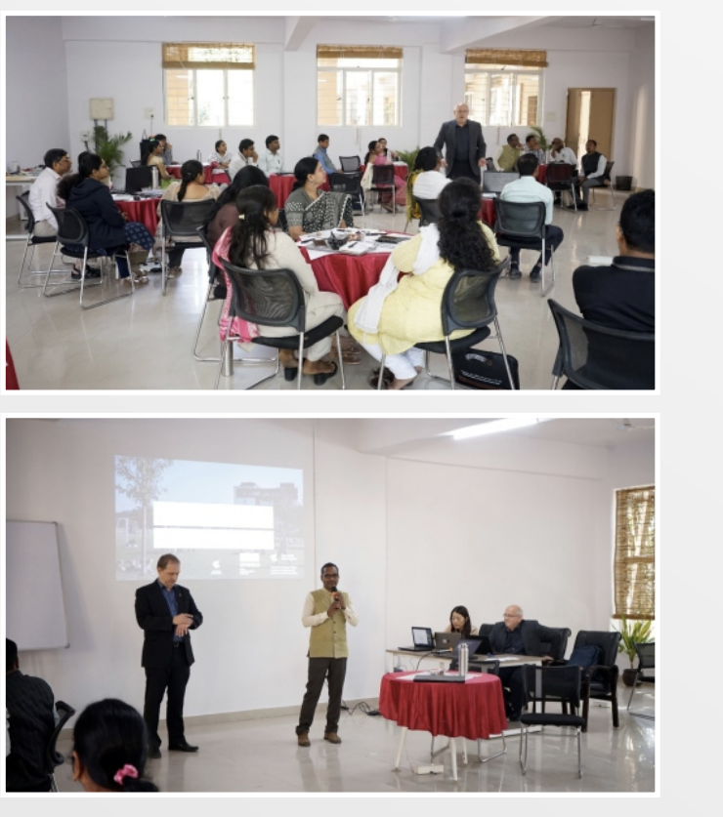
Hyderabad Institute of Technology And
Management
P A G E 7
NEWS LETTER
Dr. K. Siva Prasad, Principal Investigator, successfully led two funded research projects during the academic year:
The first project, titled “Agri Bot”, was executed over a period of six months with a funding of ₹0.17 lakhs. The project outcomes included a feasibility study, design documentation, initial hardware procurement, and a dry run of the basic bot functionality.
The second project, “An Automation System for HR Operations”, was completed in three months with a funding of ₹0.37 lakhs. This project focused on MVP (Minimum Viable Product) design, initial system development, and workflow automation for HR processes.
Funded Research Projects

Slide 8
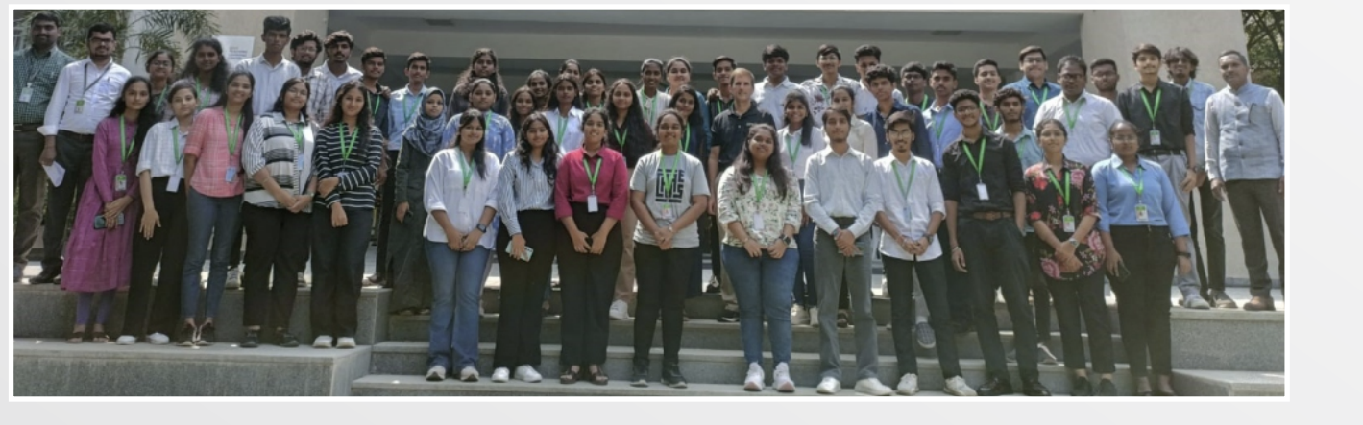
Hyderabad Institute of Technology And
Management
P A G E 8
NEWS LETTER
The Department of Mechanical Engineering at HITAM witnessed an impressive placement season for the academic year 2022–2023, with over 40 students successfully placed across core mechanical and interdisciplinary sectors.
Top recruiters included industry leaders such as Tech Destiny, Adiba Engineering Equipments, KGN Industry (Sultanpur & Jeedimetla), TCS, Tech Mahindra, Metrix Labs, and Zurn Elkay Water Solutions.
A large number of students secured roles in core mechanical domains, especially in companies like Adiba Engineering, KGN Industry, and Tech Destiny, working in areas such as design, manufacturing, maintenance, and quality assurance.
PLACEMENT ACHIEVEMENTS

Slide 9
Hyderabad Institute of Technology And
Management
P A G E 9
NEWS LETTER
Notable placements in IT and multidisciplinary sectors reflect the adaptability of HITAM's mechanical graduates. Companies like TCS, Tech Mahindra, and Metrix Labs recruited students for roles in software support, technical analytics, and consulting.
Some of the Noteworthy Selections:
  Guntuku Nithin – Zurn Elkay Water Solutions
  Mugala Haranath Narayan – TCS
  Mohd Ismail – Megha Engineering and Infrastructure Ltd.
  Thodusu Shilpa – National Small Industries Corporation (NSIC)
This successful placement drive is a reflection of the department's emphasis on industry-relevant training, skill-based learning, and academic rigor, empowering students for diverse career paths.
PLACEMENT ACHIEVEMENTS

Slide 10
Hyderabad Institute of Technology And
Management
P A G E 10
NEWS LETTER
METRIC | VALUE
Total Placed | 40+
Top Recruiters | 8+ Core/IT Firms
Industry Domains | Manufacturing, Design, Infra, IT
PLACEMENT
IMPACT
SUMMARY

