Slide 1


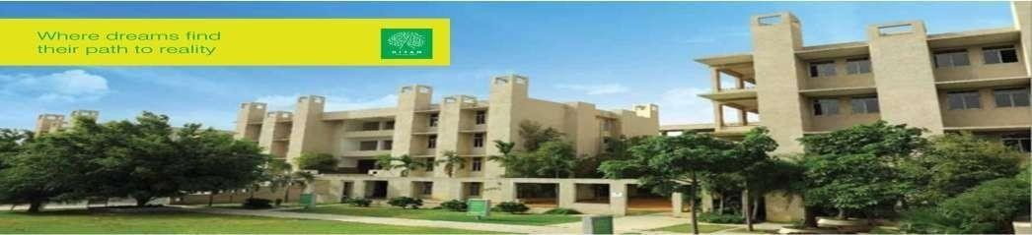
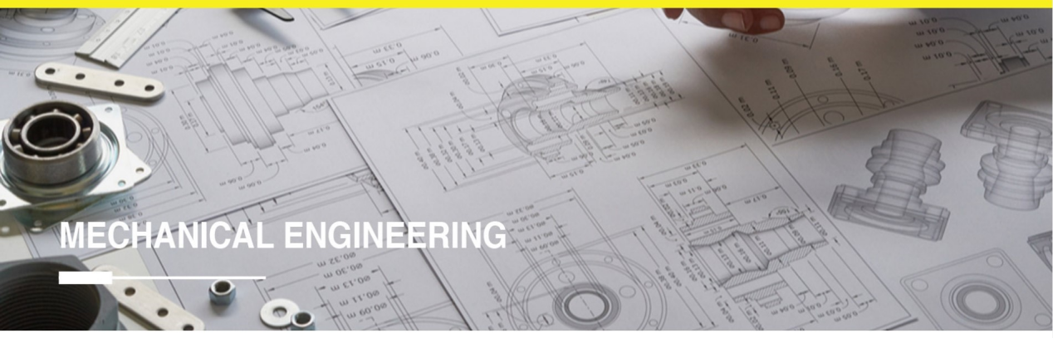
Hyderabad Institute of Technology And
Management
Volume 10 -ISSUE of May 2022- August 2022
P A G E 1
CONTENT
Department of Mechanical Engineering News Letter .
Chief Patrons :
Sri.Prashanth Arutla
(Chairman Royal Educational Society)
Editorial Team:
Mr P.Praveen (Editor-in-chief).
Dr.Rajesh Panakala
Principal,HITAM
A.Arun & K.Swapna
(Editor)

Slide 2



“
Hyderabad Institute of Technology And
Management
P A G E 2
Vision of Institute:-
NEWS LETTER
“To be a role model technological university of national repute that imparts research-based multi-disciplinary competencies in students to enable their career aspirations and contribute to society. ”
Vision and Mission of Institute
Mission of Institute:-
Build students’ competencies through HITAM’s ‘Doing Engineering’ approach with relevant curriculum, pedagogy and assessment.
Collaborate with industry and institutions for capacity building in research, innovation and real time knowledge.
Develop employability skills for emerging trends and societal needs
Excel by adopting NEP 2020 and improving accreditations &amp; national rankings.

Slide 3

Hyderabad Institute of Technology And
Management
P A G E 3
Vision of Department:-
“To be a globally recognized hub for mechanical engineering education and research, driving transformative solutions in energy, manufacturing, robotics, and sustainable design. We strive to cultivate a diverse community of engineers who lead with creativity, integrity, and a commitment to improving society through engineering innovation”.
Vision and Mission of Department
Mission of Department:-
The Mechanical Engineering Department is dedicated to fostering innovation, excellence, and leadership in education, research, and professional practice.
We aim to equip students with cutting-edge technical knowledge, practical skills, and ethical values to address global engineering challenges and contribute to sustainable technological advancements.

Slide 4

Hyderabad Institute of Technology And
Management
P A G E 4
Program Educational Objectives(PEOs)
NEWS LETTER
Program Educational Objectives
PEO 1: Graduates will excel in applying mechanical engineering principles to design and innovate solutions in industries such as energy, automotive, and manufacturing.
PEO 2: Graduates will contribute to technological advancements through research and development, addressing global challenges in sustainability and advanced systems.
PEO 3: Graduates will demonstrate leadership and collaboration in multidisciplinary teams, delivering ethical and sustainable engineering solutions.

Slide 5

Hyderabad Institute of Technology And
Management
P A G E 5
NEWS LETTER
Faculty members from the Mechanical Engineering Department actively contributed to academic development and knowledge dissemination through expert lectures and workshops during the academic year 2022–2023:
Mr Praveen took part in a session on “Robotics and Automation: Design, Control, and Communication” organized by Basava Kalyan Engineering College, Karnataka on 9th May 2022, enhancing his expertise in modern automation systems and interdisciplinary design communication.
Mr. G. Singaiah delivered an expert lecture on “Design Software Tools” at B V Raju Institute of Technology (BVRIT), Hyderabad on 24th August 2022, sharing valuable insights into design and modeling techniques for mechanical applications.
Highlights
& Institutional Achievements

Slide 6
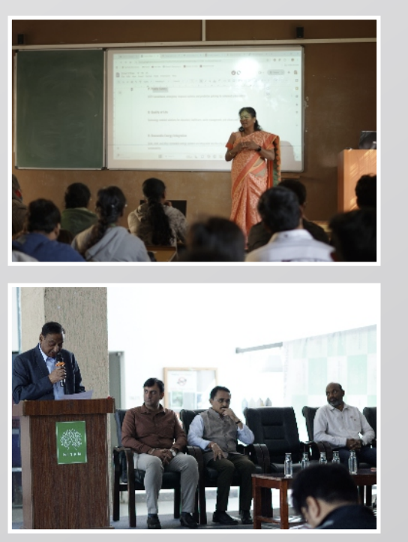
Hyderabad Institute of Technology And
Management
P A G E 6
NEWS LETTER
The Department of Mechanical Engineering organized a A Three-Day FDP on "Recent Developments in Renewable Energy Technologies“ from 28th July 2022 onwards with Dr. Ravikumar Bhimasingu from IIT Hyderabad as the resource person.
The FDP focused on the latest advancements in renewable energy, including solar, wind, and energy storage technologies, equipping faculty members with the knowledge to integrate these developments into their curriculum.
FDP was an initiative for the department’s ongoing effort to foster research and innovation in energy technologies, while also aligning with global sustainability goals.
Faculty Development Program

Slide 7
Hyderabad Institute of Technology And
Management
P A G E 7
NEWS LETTER
Faculty members from the Department of Mechanical Engineering played active roles in organizing and mentoring students during key academic events. Their participation has greatly contributed to the success and technical quality of student-centered activities.
Mr. Santosh Naik, Mr. SNS Santhosh, and Mr. P. Praveen served as event coordinators and evaluators for Project Expo 2022 held on 2nd June 2022 at HITAM.
This event showcased innovative student projects, encouraging design thinking, practical application of classroom learning, and interdisciplinary collaboration.
Achievements

Slide 8
Hyderabad Institute of Technology And
Management
P A G E 8
NEWS LETTER
The 76th Independence Day was celebrated with great patriotism and enthusiasm at Hyderabad Institute of Technology and Management (HITAM) on 15th August 2022.
The entire campus was adorned with tricolour decorations, and the spirit of freedom and unity resonated throughout the event.The event was held in the campus courtyard and attended by students, faculty, and staff.
The celebration commenced with the hoisting of the national flag by the Director, followed by the singing of the National Anthem, creating an atmosphere of unity and reverence.In his address, the Director highlighted the importance of the Constitution of India and encouraged students to become responsible citizens contributing positively to the nation.
Independence day celebration

Slide 9
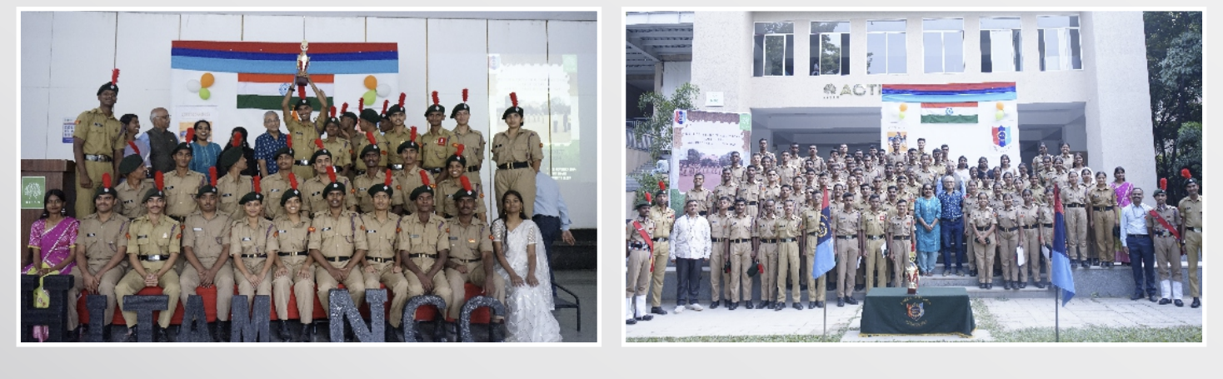
Hyderabad Institute of Technology And
Management
P A G E 9
NEWS LETTER
Mr SNS Santosh has contributed significantly to make the event enhancing.Students from various departments presented patriotic songs, speeches, and cultural performances reflecting the spirit of the day.
A special skit by Mechanical Engineering students emphasized the role of youth in building a progressive and inclusive India.
The event concluded with a vote of thanks and the distribution of refreshments. The celebration served as a reminder of India’s democratic values and HITAM's commitment to fostering civic responsibility and national spirit among students.
Republic day celebration

