Slide 1




Hyderabad Institute of Technology And
Management
Volume 8 -ISSUE of July 2021- December 2021
P A G E 1
CONTENT
Department of Mechanical Engineering News Letter .
Chief Patrons :
Sri.Prashanth Arutla
(Chairman Royal Educational Society)
Editorial Team:
Mr SNS Santosh (Editor-in-chief).
Dr.Rajesh Panakala
Principal,HITAM
M.Srinu & C.Manoj
(Editor)

Slide 2



“
Hyderabad Institute of Technology And
Management
P A G E 2
Vision of Institute:-
NEWS LETTER
“To be a role model technological university of national repute that imparts research-based multi-disciplinary competencies in students to enable their career aspirations and contribute to society. ”
Vision and Mission of Institute
Mission of Institute:-
Build students’ competencies through HITAM’s ‘Doing Engineering’ approach with relevant curriculum, pedagogy and assessment.
Collaborate with industry and institutions for capacity building in research, innovation and real time knowledge.
Develop employability skills for emerging trends and societal needs
Excel by adopting NEP 2020 and improving accreditations &amp; national rankings.

Slide 3

Hyderabad Institute of Technology And
Management
P A G E 3
Vision of Department:-
“To be a globally recognized hub for mechanical engineering education and research, driving transformative solutions in energy, manufacturing, robotics, and sustainable design. We strive to cultivate a diverse community of engineers who lead with creativity, integrity, and a commitment to improving society through engineering innovation”.
Vision and Mission of Department
Mission of Department:-
The Mechanical Engineering Department is dedicated to fostering innovation, excellence, and leadership in education, research, and professional practice.
We aim to equip students with cutting-edge technical knowledge, practical skills, and ethical values to address global engineering challenges and contribute to sustainable technological advancements.

Slide 4

Hyderabad Institute of Technology And
Management
P A G E 4
Program Educational Objectives(PEOs)
NEWS LETTER
Program Educational Objectives
PEO 1: Graduates will excel in applying mechanical engineering principles to design and innovate solutions in industries such as energy, automotive, and manufacturing.
PEO 2: Graduates will contribute to technological advancements through research and development, addressing global challenges in sustainability and advanced systems.
PEO 3: Graduates will demonstrate leadership and collaboration in multidisciplinary teams, delivering ethical and sustainable engineering solutions.

Slide 5

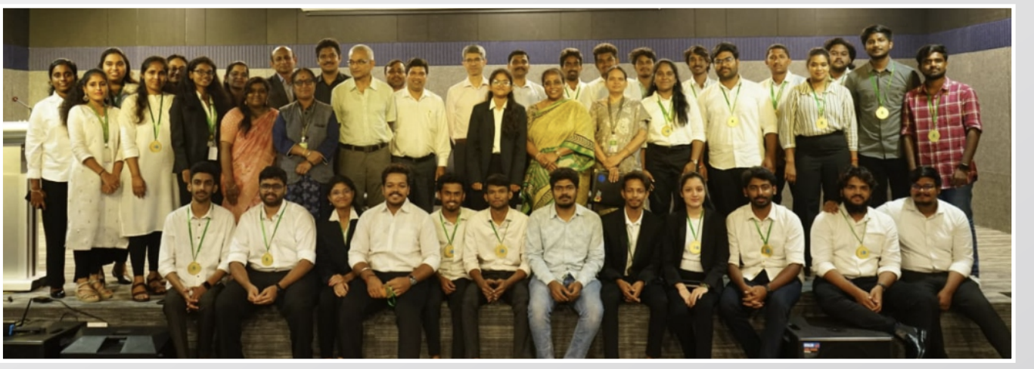
Hyderabad Institute of Technology And
Management
P A G E 5
NEWS LETTER
Funded Project:
Mr. Santosh Naik received a grant of ₹1.75 Lacs under Unnat Bharath Abhiyan for the "Perennial Fund Award" project through the UBA Cell at HITAM.
Mentorship in Innovation Projects:
Dr. K. Shiva Prasad: Guided "Robothon 2021" (17/08/2021) at MCEME and "Algae-Based Sewage Treatment Plant" (01/05/2023).
Mr. P. Praveen: Mentored "OCTACLEANER" (08/09/2022) under Institution’s Innovation Council (IIC).
Faculty Research & Mentorship

Slide 6
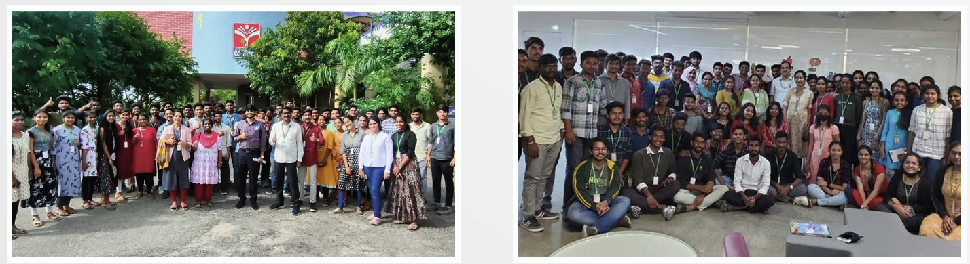
Hyderabad Institute of Technology And
Management
P A G E 6
NEWS LETTER
FDP/FDP Resource Persons
Mr. Santosh Naik: Delivered a talk on "Pitching Event for Ideas Scouted" at Jain College of Engineering, Belagavi (21/02/2021)
Mr. P.V.N. Sai Chandu: Spoke at HITAM's FDP on Heat Transfer and Fluid Mechanics (10/03/2021).
Highlights
& Institutional Achievements

Slide 7
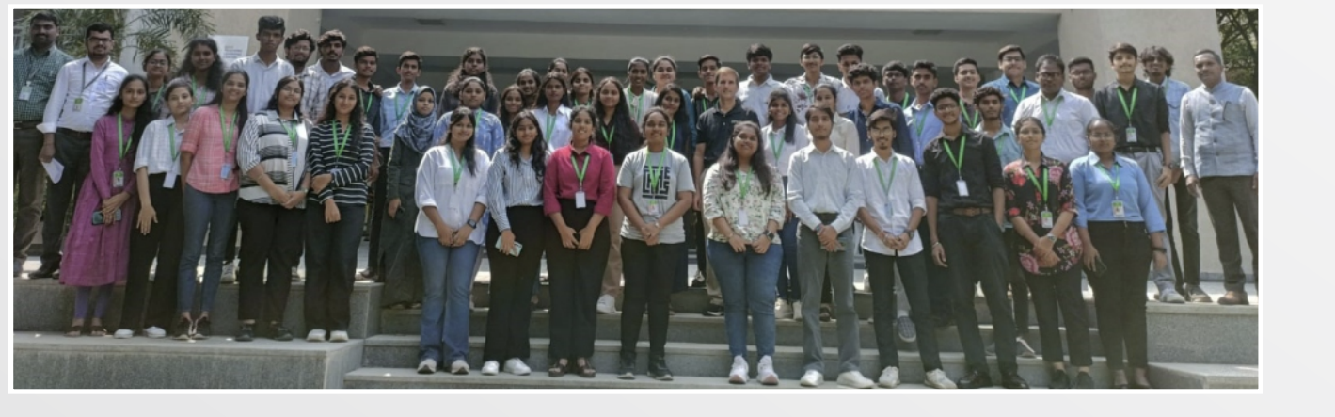
Hyderabad Institute of Technology And
Management
P A G E 7
NEWS LETTER
Student Achievements
Participation in national-level technical contests:
  Hack Your Path 4.0 (19/12/2022): B. Sathish, N. Sreekaran Reddy, K.C. Pranith.
  Project Expo (07/04/2023): Multiple students from ME dept including K. Sandeep, A. Arun, G. Sandeep, and T. Shilpa.
Highlights
& Institutional Achievements

Slide 8
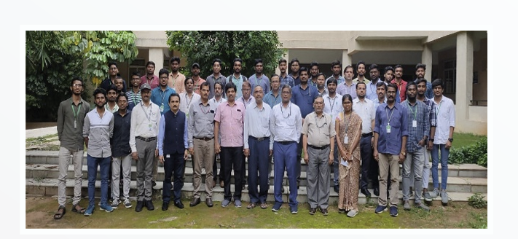
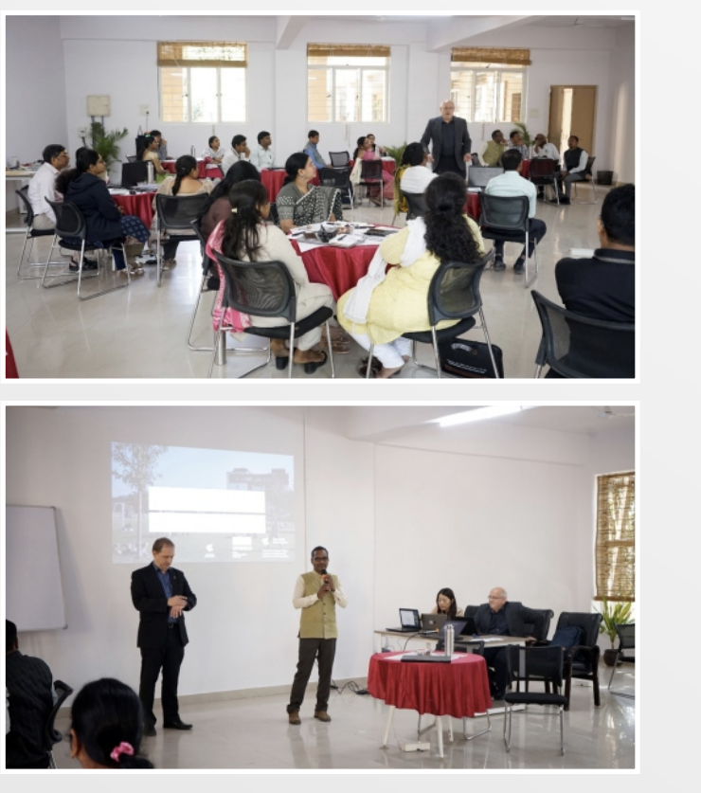
Hyderabad Institute of Technology And
Management
P A G E 8
NEWS LETTER
National-level "Inno-Fiesta" organized by IUC-Engineers Without Borders on 21 & 22 June 2022.
Events Organized

Slide 9
Hyderabad Institute of Technology And
Management
P A G E 9
NEWS LETTER
The Department of Mechanical Engineering takes pride in announcing that 60+ students from the 2019–2023 batch have been successfully placed in reputed organizations across core and IT/tech domains.
Core Companies: KGN Industries, Adiba Engineering Equipments, Accordion Technologies
IT/Tech Companies: Capgemini, Intellipaat, TCS, Kreeti Technologies
Noteworthy Achievers:
Himanish Dutt – Intellipaat
P. Srikanth – Kreeti Technologies
T.M. Aravind – Intellipaat
B. Lahari – Accordion Technologies
These placements reflect the department’s dedication toward skill development, industry readiness, and holistic student growth.
PLACEMENT ACHIEVEMENTS
For feedback or to contribute to the next issue, contact: mechengg@hitam.org

