Slide 1


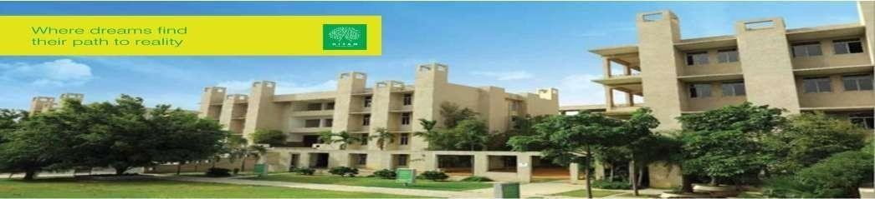

Hyderabad Institute of Technology And
Management
Volume 7 -ISSUE of January 2021- June 2021
P A G E 1
CONTENT
Department of Mechanical Engineering News Letter .
Chief Patrons :
Sri.Prashanth Arutla
(Chairman Royal Educational Society)
Editorial Team:
Mr Y Anil Reddy(Editor-in-chief).
Dr.Rajesh Panakala
Principal,HITAM
K Akshay Kumar & C Manoj
(Editor)

Slide 2



“
Hyderabad Institute of Technology And
Management
P A G E 2
Vision of Institute:-
NEWS LETTER
“To be a role model technological university of national repute that imparts research-based multi-disciplinary competencies in students to enable their career aspirations and contribute to society. ”
Vision and Mission of Institute
Mission of Institute:-
Build students’ competencies through HITAM’s ‘Doing Engineering’ approach with relevant curriculum, pedagogy and assessment.
Collaborate with industry and institutions for capacity building in research, innovation and real time knowledge.
Develop employability skills for emerging trends and societal needs
Excel by adopting NEP 2020 and improving accreditations &amp; national rankings.

Slide 3

Hyderabad Institute of Technology And
Management
P A G E 3
Vision of Department:-
“To be a globally recognized hub for mechanical engineering education and research, driving transformative solutions in energy, manufacturing, robotics, and sustainable design. We strive to cultivate a diverse community of engineers who lead with creativity, integrity, and a commitment to improving society through engineering innovation”.
Vision and Mission of Department
Mission of Department:-
The Mechanical Engineering Department is dedicated to fostering innovation, excellence, and leadership in education, research, and professional practice.
We aim to equip students with cutting-edge technical knowledge, practical skills, and ethical values to address global engineering challenges and contribute to sustainable technological advancements.

Slide 4

Hyderabad Institute of Technology And
Management
P A G E 4
Program Educational Objectives(PEOs)
NEWS LETTER
Program Educational Objectives
PEO 1: Graduates will excel in applying mechanical engineering principles to design and innovate solutions in industries such as energy, automotive, and manufacturing.
PEO 2: Graduates will contribute to technological advancements through research and development, addressing global challenges in sustainability and advanced systems.
PEO 3: Graduates will demonstrate leadership and collaboration in multidisciplinary teams, delivering ethical and sustainable engineering solutions.

Slide 5

Hyderabad Institute of Technology And
Management
P A G E 5
NEWS LETTER
FDP Organized: Conducted a 7-day FDP on "Advances in Computer-Aided Design and Product Innovation" from 25/09/2021. Dr. P.V. Ramana, Professor, MGIT Hyderabad, served as the resource person.
Faculty as Resource Persons:
  Mr. P. Praveen: Delivered a session on "Emerging Trends in Electric Vehicles: Power Systems, Control, and Connectivity" at Basava Kalyan Engineering College, Karnataka (12/08/2021).
  Mr. SNS Santosh: Spoke at Gulbarga Shetty College on "Multidisciplinary Approaches in Renewable Energy and Power Management Systems" (10/02/2022).
Academic and Faculty Contributions

Slide 6
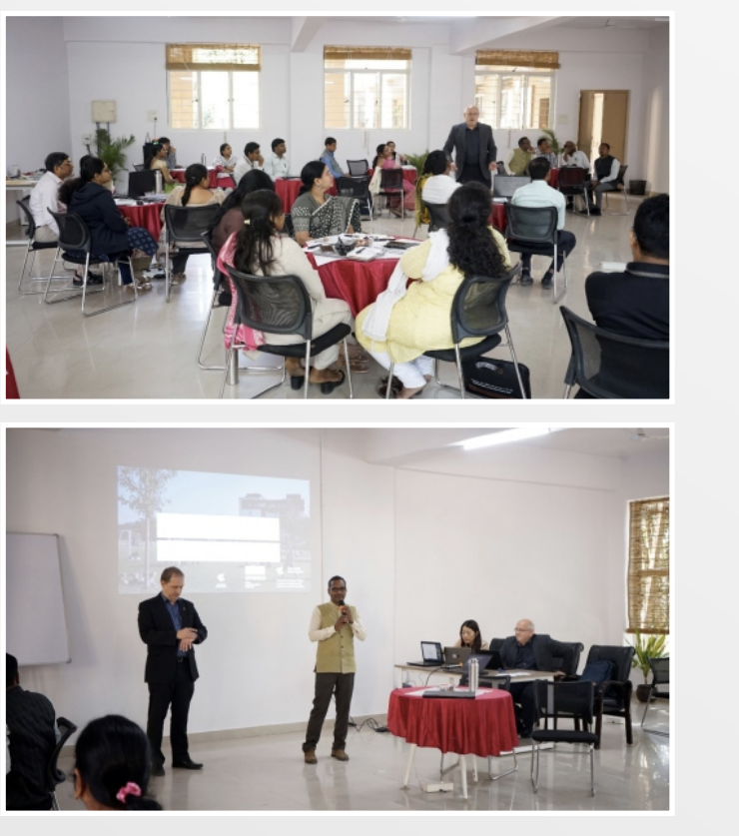
Hyderabad Institute of Technology And
Management
P A G E 6
NEWS LETTER
Faculty developed several working models and prototypes:
Mr. Singaiah G: Experimental setup for stress and strain measurement for railway bridge health monitoring.
Dr. K. Siva Prasad: Vertical forming machine.
Mr. Ashish Kumar Singh: Structural and vibrational analysis of a conical gearbox & water level controller.
Mr. Y. Anil Reddy: Design and development of an electric bike.
Mr. P.V.N. Sai Chandu: Solar grass cutter and parametric concrete printing machine.
Others included hybrid sewing machine, pneumatic vice, and centrifugal pump analysis.
Faculty Innovations & Prototypes

Slide 7
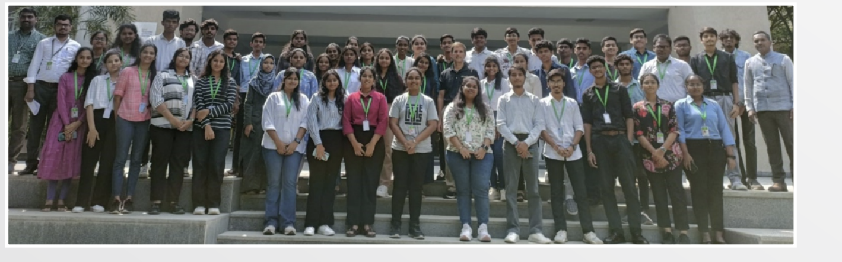
Hyderabad Institute of Technology And
Management
P A G E 7
NEWS LETTER
Students actively took part in Hackathons and Project Expos at the National level:
Hackathon (11/03/2022): S. Ashish, C. Manoj, T.M. Aravind, B. Pawan Kumar.
Project Expo (26/03/2022): G. Anand, P. Nikhil, S. Salman, T. Gita, N. Ganesh.
Student Participation in National-Level Events

Slide 8

Hyderabad Institute of Technology And
Management
P A G E 8
NEWS LETTER
Himanish Dutt and Aashish Sharma (2nd semester) presented at the IEEE Xplore indexed "ICSRC 2021" on Sustainability and Resilience. Volume 3, Issue 1.
Research
Publications
For feedback or to contribute to the next issue, contact: mechengg@hitam.org

